Slide 1


INF 112
OBLIG 4
GROUP 6
TEAM PRESENTATION

Slide 2







Sverre – Code
Loc – Graphics
Benjamin – SQL
Eirik – Code
Stian – AI & Version control
Vegard – Documentation & UI
Robin E – Sound
Robin G – UI
1
of
6

Slide 3
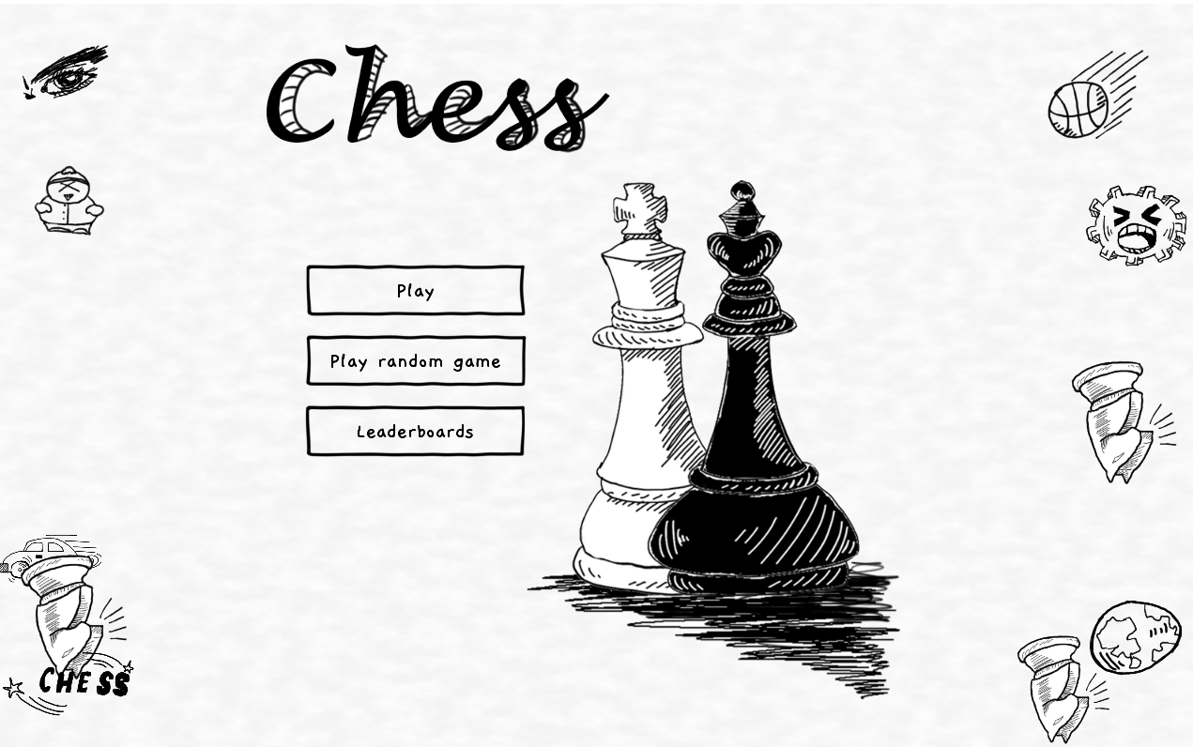
2
of
6

Slide 4
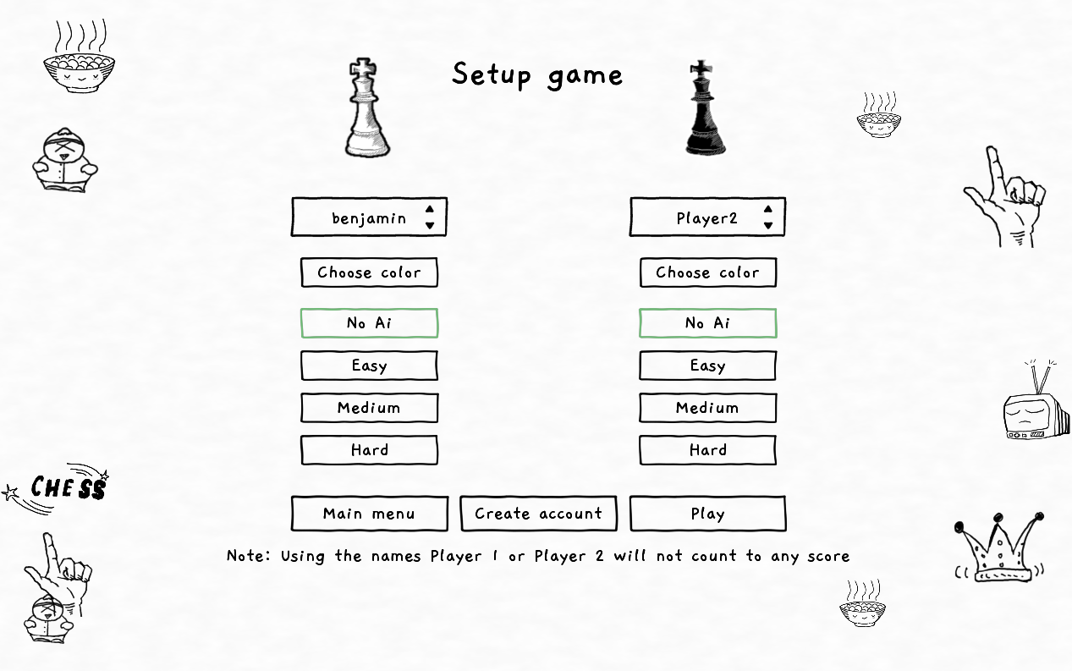
2
of
6

Slide 5
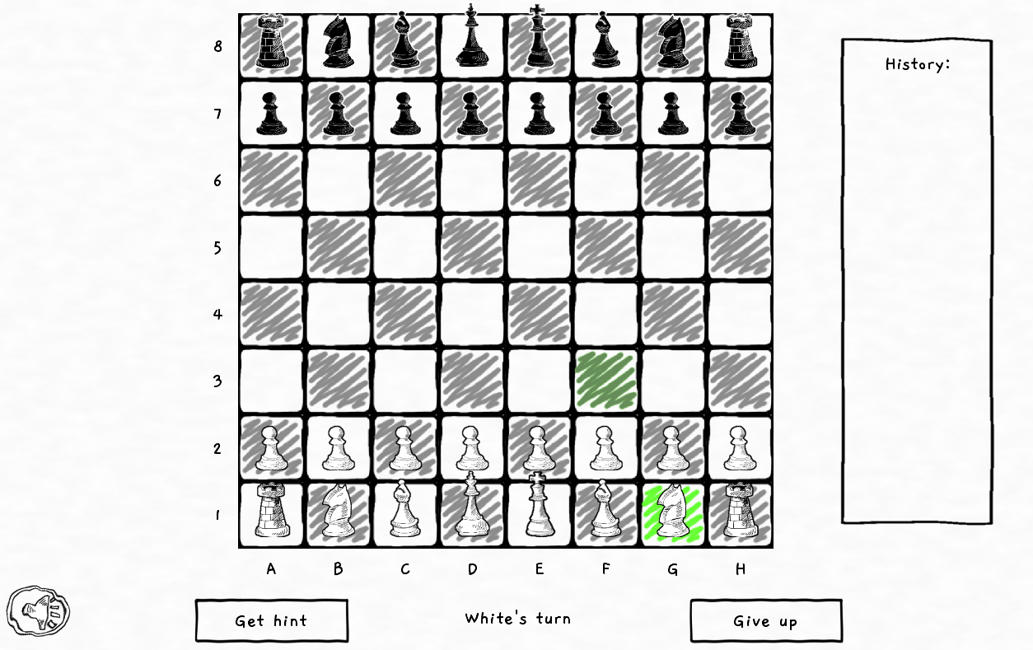
2
of
6

Slide 6
Demo video
6
of
9

Slide 7
RESULTS &
CHALLENGES
A retrospective
Good
From Maven to Gradle
Continuous Integration
Improved use of issues
Bad
UI competence and frontend shift
Role entrenchment in general
Bad scheduling
Test neglection
2
of
6

Slide 8
THANK YOU

